Slide 1


Spatial Modelling
Part 1
Earl Duncan
Bayes on the Beach Conference
13-15 Nov 2017

Slide 2
Overview Spatial Data Modelling Framework Common Models R
Part 1:
What is spatial data?
How does the spatial nature of data impact modelling/inference?
General modelling framework
Common Bayesian spatial models
Fitting models in R using CARBayes
Part 2:
Model checking
Summarising model output (maps, scatterplots)
Making inferences
Part 3:
Sharing our results with the other groups
Part 1:
What is spatial data?
How does the spatial nature of data impact modelling/inference?
General modelling framework
Common Bayesian spatial models
Fitting models in R using CARBayes
Part 2:
Model checking
Summarising model output (maps, scatterplots)
Making inferences
Part 3:
Sharing our results with the other groups
Earl Duncan Bayes on the Beach Conference 2017 Workshop 1/12

Slide 3
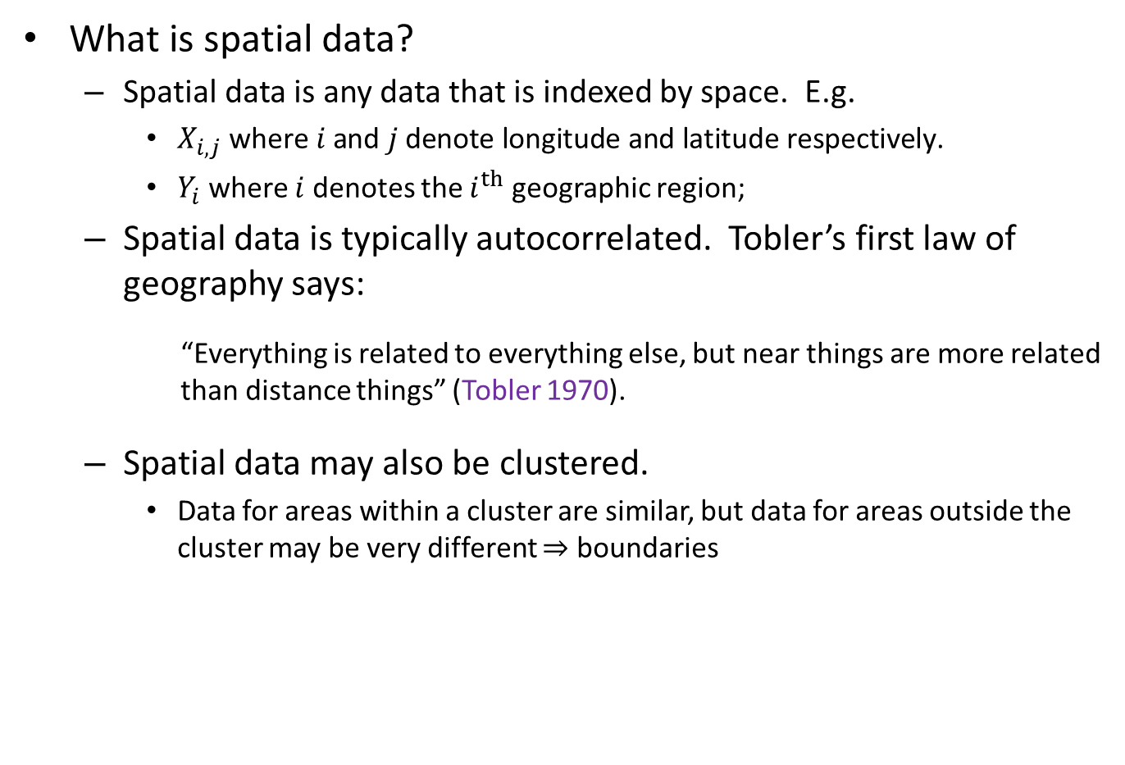
Overview Spatial Data Modelling Framework Common Models R
What is spatial data?
Spatial data is any data that is indexed by space. E.g.
$X_{i,j} \text{where} i \text{and} j \text{denote} \text{longitude} \text{and} \text{latitude} \text{respectively}\text{.}$
$Y_{i}$ where $i$ denotes the $i^{th}$ geographic region;
Spatial data is typically autocorrelated. Tobler’s first law of geography says:
“Everything is related to everything else, but near things are more related than distance things” (Tobler 1970).
Spatial data may also be clustered.
Data for areas within a cluster are similar, but data for areas outside the cluster may be very different $⇒$ boundaries
Earl Duncan Bayes on the Beach Conference 2017 Workshop 2/12

Slide 4
Overview Spatial Data Modelling Framework Common Models R
How does the spatial nature of data impact modelling/ inference?
If spatial data is autocorrelated and/or clustered, and this is not taken into account, then:
Models residuals will not be independent;
Model estimates will have a larger variance;
Inference will be erroneous.
How do we take this into account?
Spatial random effects (carefully structured)
Very easy to do in a Bayesian hierarchical model!
Spatial modelling is very popular in epidemiology and ecology.
We will consider count data in epidemiological context. (This permits the creation of very interesting disease maps).
Earl Duncan Bayes on the Beach Conference 2017 Workshop 3/12

Slide 5

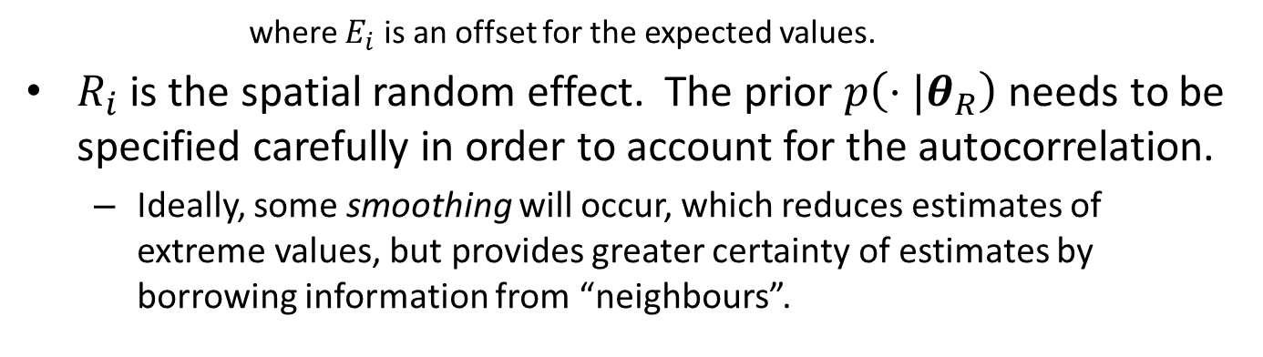


Overview Spatial Data Modelling Framework Common Models R
Modelling framework (GLMM):
3-stage model (see Best et al. 2005)
Stage 1:
$$y_{i} \sim Po\left(E_{i}e^{μ_{i}}\right)$$
Stage 2:
$$μ_{i}=α+x_{i}^{T}β+R_{i}$$
Stage 3:
$$α \sim p\left(⋅|θ_{α}\right)$$
$$β \sim p\left(⋅|θ_{β}\right)$$
$$R_{i} \sim p\left(⋅|θ_{R}\right)$$
where $E_{i}$ is an offset for the expected values.
$R_{i}$ is the spatial random effect. The prior $p\left(⋅|θ_{R}\right)$ needs to be specified carefully in order to account for the autocorrelation.
Ideally, some smoothing will occur, which reduces estimates of extreme values, but provides greater certainty of estimates by borrowing information from “neighbours”.
Earl Duncan Bayes on the Beach Conference 2017 Workshop 4/12

Slide 6
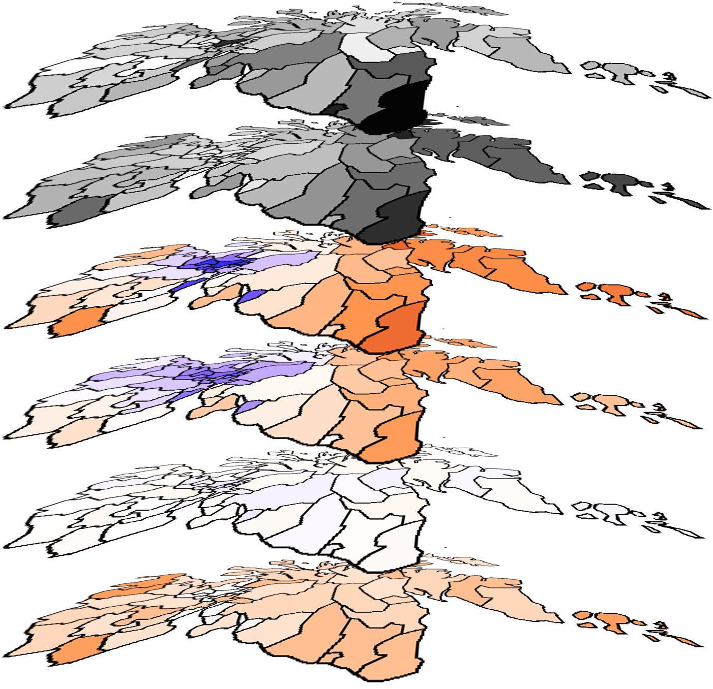

Overview Spatial Data Modelling Framework Common Models R
Parameter estimates provide insight into the ‘layers’:
$$y_{i}$$
Relative risk: $e^{μ_{i}}$
$$μ_{i}$$
$R_{i}$ (smooth)
$R_{i}$ (noise)
$$βx_{i}$$
Earl Duncan Bayes on the Beach Conference 2017 Workshop 5/12

Slide 7
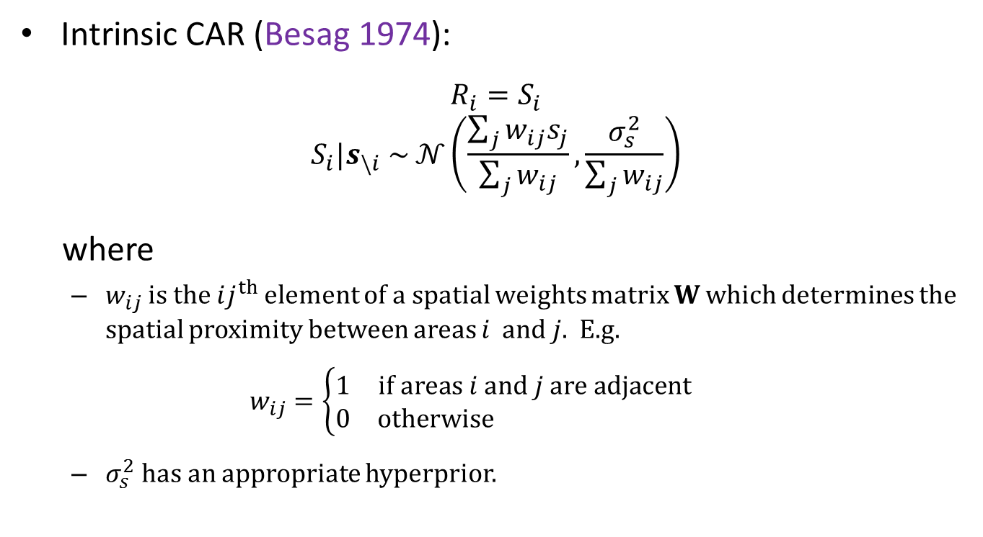
Overview Spatial Data Modelling Framework Common Models R
Intrinsic CAR (Besag 1974):
$$R_{i}=S_{i}$$
$$S_{i}|s_{\backslash i} \sim 𝒩\left(\frac{\sum_{j}{w_{ij}s_{j}}}{\sum_{j}{w_{ij}}}, \frac{σ_{s}^{2}}{\sum_{j}{w_{ij}}}\right)$$
where
$w_{ij}$ is the $ij^{th}$ element of a spatial weights matrix $W$ which determines the spatial proximity between areas $i$ and $j$. E.g.
$$w_{ij}=\left\{\begin{matrix}1 & if areas i and j are adjacent \\ 0 & otherwise \end{matrix}\right.$$
$σ_{s}^{2}$ has an appropriate hyperprior.
Besag, J. 1974. Spatial interaction and the statistical analysis of lattice systems. Journal of the Royal Statistical Society: Series B (Statistical Methodology) 36 (2): 192-236.
Earl Duncan Bayes on the Beach Conference 2017 Workshop 6/12

Slide 8
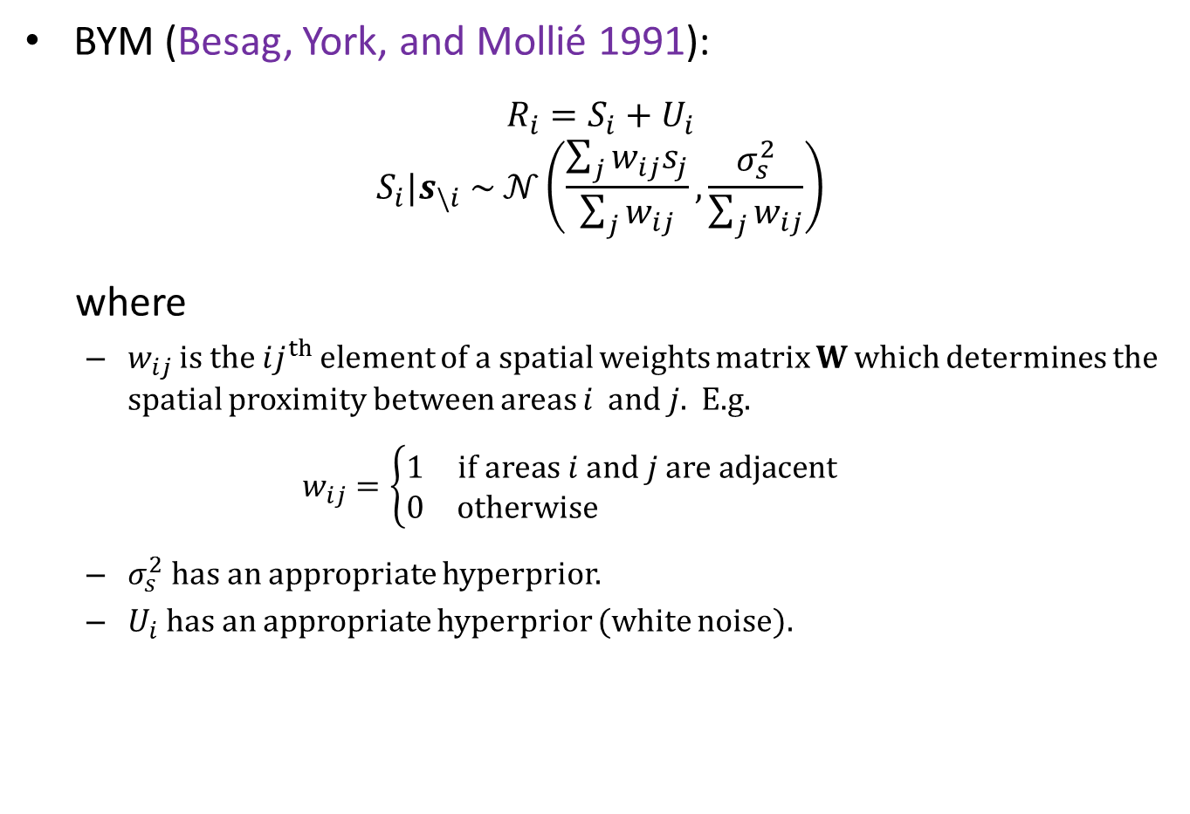
Overview Spatial Data Modelling Framework Common Models R
BYM (Besag, York, and Mollié 1991):
$$R_{i}=S_{i}+U_{i}$$
$$S_{i}|s_{\backslash i} \sim 𝒩\left(\frac{\sum_{j}{w_{ij}s_{j}}}{\sum_{j}{w_{ij}}}, \frac{σ_{s}^{2}}{\sum_{j}{w_{ij}}}\right)$$
where
$w_{ij}$ is the $ij^{th}$ element of a spatial weights matrix $W$ which determines the spatial proximity between areas $i$ and $j$. E.g.
$$w_{ij}=\left\{\begin{matrix}1 & if areas i and j are adjacent \\ 0 & otherwise \end{matrix}\right.$$
$σ_{s}^{2}$ has an appropriate hyperprior.
$U_{i}$ has an appropriate hyperprior (white noise).
Besag, J., J. York, and A. Mollié. 1991. Bayesian image restoration with application in spatial statistics. Annals of the Institute of Statistical Mathematics 43 (1):1-20. doi: 10.1007/BF00116466.
Earl Duncan Bayes on the Beach Conference 2017 Workshop 7/12

Slide 9
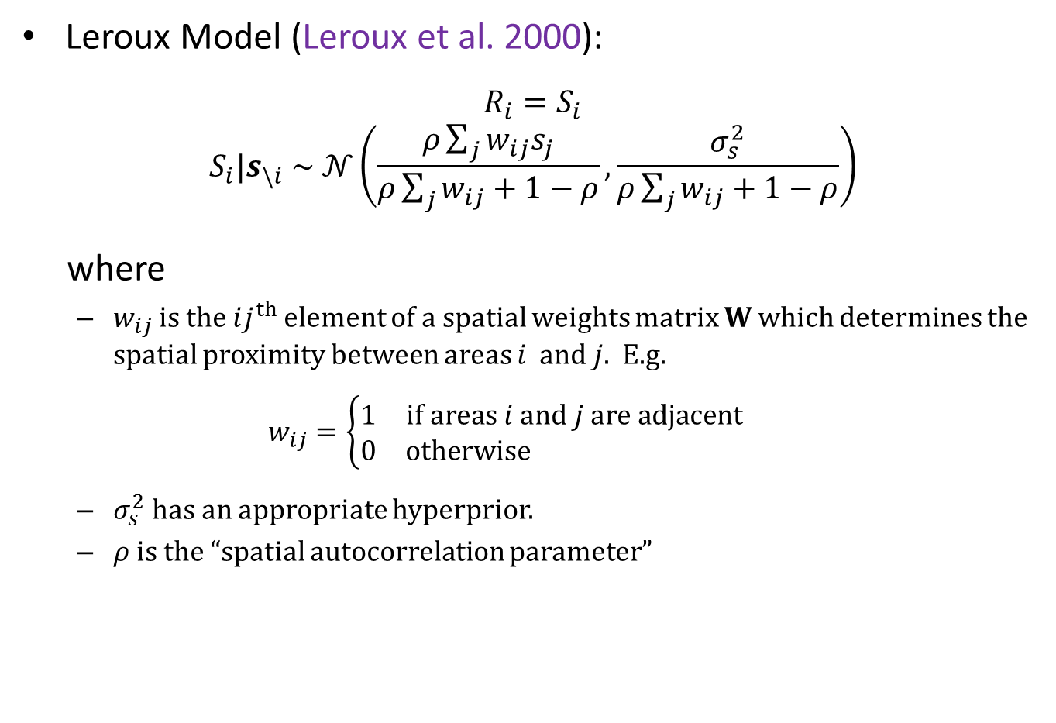
Overview Spatial Data Modelling Framework Common Models R
Leroux Model (Leroux et al. 2000):
$$R_{i}=S_{i}$$
$$S_{i}|s_{\backslash i} \sim 𝒩\left(\frac{ρ\sum_{j}{w_{ij}s_{j}}}{ρ\sum_{j}{w_{ij}}+1−ρ}, \frac{σ_{s}^{2}}{ρ\sum_{j}{w_{ij}}+1−ρ}\right)$$
where
$w_{ij}$ is the $ij^{th}$ element of a spatial weights matrix $W$ which determines the spatial proximity between areas $i$ and $j$. E.g.
$$w_{ij}=\left\{\begin{matrix}1 & if areas i and j are adjacent \\ 0 & otherwise \end{matrix}\right.$$
$σ_{s}^{2}$ has an appropriate hyperprior.
$ρ$ is the “spatial autocorrelation parameter”
Leroux, B. G., X. Lei, and N. Breslow. 2000. “Estimation of disease rates in small areas: a new mixed model for spatial dependence”. In Statistial models in epidemiology, the environment and clinical trials, edited by M. E. Halloran and D. Berry, pp. 179-191. The IMA Volumes in Mathematics and its Applications, vol 116. New York: Springer. doi: 10.1007/978-1-4612-1284-3_4.
Earl Duncan Bayes on the Beach Conference 2017 Workshop 8/12

Slide 10
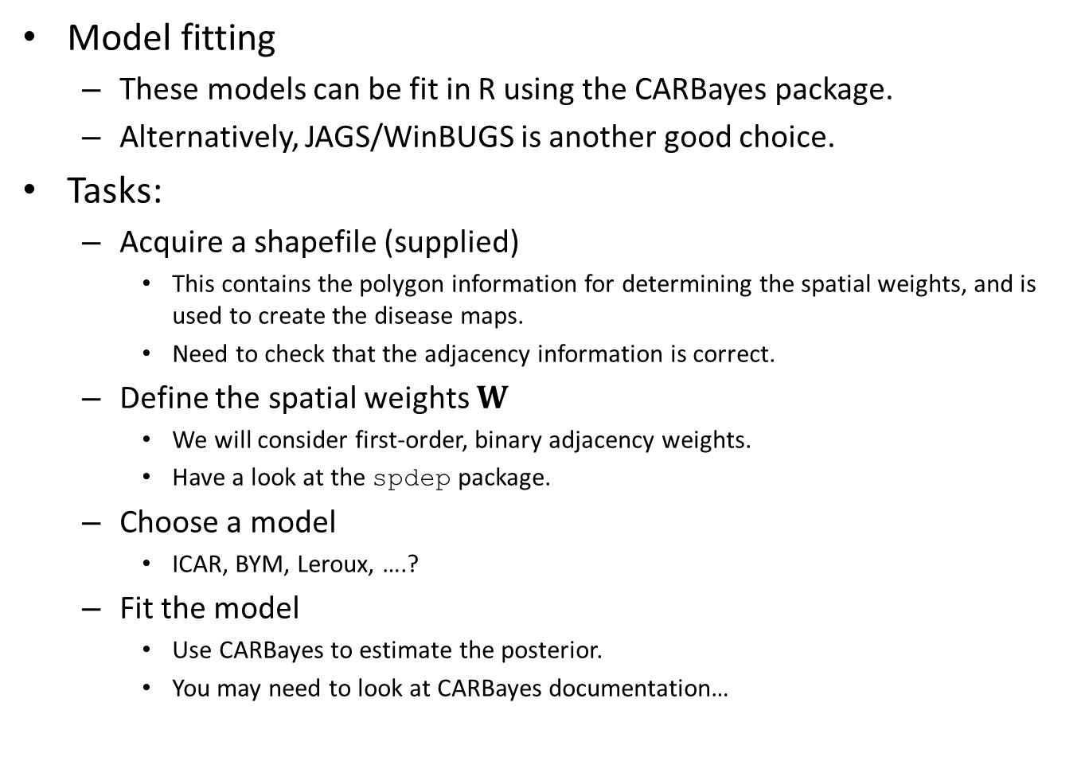
Overview Spatial Data Modelling Framework Common Models R
Model fitting
These models can be fit in R using the CARBayes package.
Alternatively, JAGS/WinBUGS is another good choice.
Tasks:
Acquire a shapefile (supplied)
This contains the polygon information for determining the spatial weights, and is used to create the disease maps.
Need to check that the adjacency information is correct.
Define the spatial weights $W$
We will consider first-order, binary adjacency weights.
Have a look at the spdep package.
Choose a model
ICAR, BYM, Leroux, ….?
Fit the model
Use CARBayes to estimate the posterior.
You may need to look at CARBayes documentation…
Earl Duncan Bayes on the Beach Conference 2017 Workshop 9/12

Slide 11
Overview Spatial Data Modelling Framework Common Models R
Downloads
CARBayes documentation:
https://cran.r-project.org/web/packages/CARBayes/CARBayes.pdf
https://cran.r-project.org/web/packages/CARBayes/vignettes/CARBayes.pdf
JAGS:
https://sourceforge.net/projects/mcmc-jags/files/
Use the R2jags R package.
WinBUGS
https://www.mrc-bsu.cam.ac.uk/software/bugs/the-bugs-project-winbugs/
Install WinBUGS 1.4 > Download key for unrestricted use > Patch 1.4.3
Use the R2WinBUGS package
Shapefile
Scotland shapefile was taken from http://www.stat.osu.edu/~pfc/teaching/5012_ spatial_statistics/datasets/Scottish_shapefile.Rdata
Earl Duncan Bayes on the Beach Conference 2017 Workshop 10/12

Slide 12
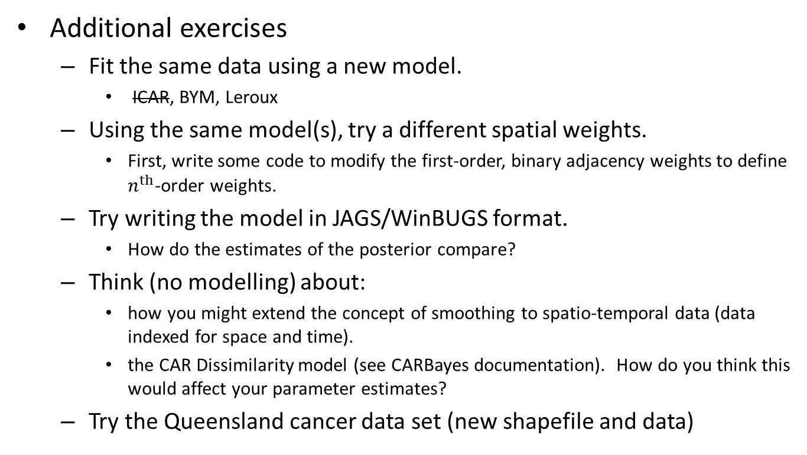
Overview Spatial Data Modelling Framework Common Models R
Additional exercises
Fit the same data using a new model.
ICAR, BYM, Leroux
Using the same model(s), try a different spatial weights.
First, write some code to modify the first-order, binary adjacency weights to define $n^{th}$-order weights.
Try writing the model in JAGS/WinBUGS format.
How do the estimates of the posterior compare?
Think (no modelling) about:
how you might extend the concept of smoothing to spatio-temporal data (data indexed for space and time).
the CAR Dissimilarity model (see CARBayes documentation). How do you think this would affect your parameter estimates?
Try the Queensland cancer data set (new shapefile and data)
Earl Duncan Bayes on the Beach Conference 2017 Workshop 11/12

Slide 13
Overview Spatial Data Modelling Framework Common Models R
References:
Besag, J. 1974. Spatial interaction and the statistical analysis of lattice systems. Journal of the Royal Statistical Society: Series B (Statistical Methodology) 36 (2): 192-236.
Besag, J., J. York, and A. Mollié. 1991. Bayesian image restoration with application in spatial statistics. Annals of the Institute of Statistical Mathematics 43 (1):1-20. doi: 10.1007/BF00116466.
Leroux, B. G., X. Lei, and N. Breslow. 2000. “Estimation of disease rates in small areas: a new mixed model for spatial dependence”. In Statistial models in epidemiology, the environment and clinical trials, edited by M. E. Halloran and D. Berry, pp. 179-191. The IMA Volumes in Mathematics and its Applications, vol 116. New York: Springer. doi: 10.1007/978-1-4612-1284-3_4.
Lee, D. 2013. CARBayes: An R package for Bayesian spatial modelling with conditional autoregressive priors. Journal of Statistical Software 55 (13): 1-24. URL: http://www.jstatsoft.org/v55/i13/.
Lee, D. and R. Mitchell. 2012. Boundary detection in disease mapping studies. Biostatistics 13 (3): 415-426. doi: 10.1093/biostatistics/kxr036.
Earl Duncan Bayes on the Beach Conference 2017 Workshop 12/12

